Slide 1
7 Geoprocessing/spatial Analysis Tools Every GIS Analyst Should Know

Slide 2
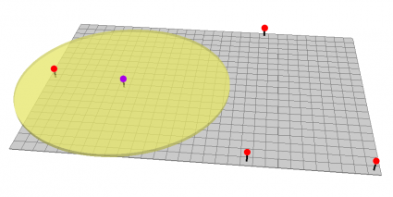
1. The Buffer Tool
Buffers are proximity functions. When you use this geoprocessing tool, it creates a polygon at a set distance surrounding the features.
For example,
a buffer is a polygon or collection of cells
that are within a specified proximity of a set of features.
The buffer tool can have fixed and variable distances.
Also, they can be set to geodesic which accounts for the curvature of the Earth.

Slide 3
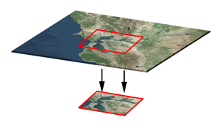
2. The Clip Tool
The clip tool is an overlay function that cuts out an input layer to the extent of a defined feature boundary. The result of this tool is a new clipped output layer.
If you can picture a cookie cutter,
this is like using the clip tool. And
carving out vectors and rasters is one of
the most common operations in GIS.
To clip data, you need points, lines, or polygons as input and a polygon as the clipping extent. The preserved data is the result of a clip.

Slide 4
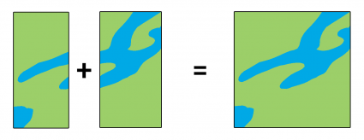
3. The Merge Tool
The merge tool combines data sets that are the same data type (points, lines, or polygons). When you run the merge tool, the resulting data will be merged into one.
Similar to the clip tool, we use the merge tool regularly. For merging, data sets have to be the same type. For example, you can’t merge points and polygons into one data set.

Slide 5
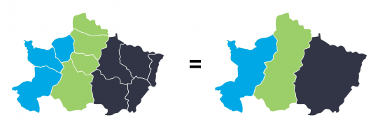
4. The Dissolve Tool
The dissolve tool unifies boundaries based on common attribute values. In other words, dissolve merges neighboring boundaries if the neighbors have the same attributes.
For example, if you want to remove the borders of countries to form a continent, the dissolve tool is the tool to use. But you would need an attribute for each country and the continent it belongs to.

Slide 6
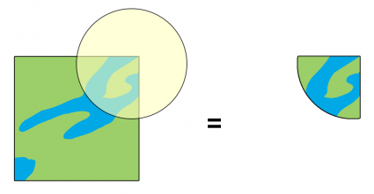
5. The Intersect Tool
The intersect tool is very similar to the clip tool because the extents of input features define the output. The only exception is that it preserves attributes from all the data sets that overlap each other in the output.
The intersect tool performs a geometric overlap. All features that overlap in all layers will be part of the output feature class – attributes preserved.
Add multiple inputs. The tool accepts different data types (points, lines, and polygons). When features overlap each other, they will be in the output. The intersect tool preserves the attribute values in both input layers.

Slide 7
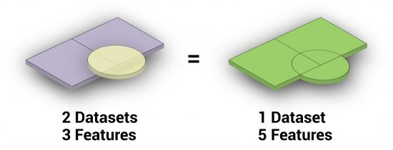
6. The Union Tool
The union tool gets a bad reputation because it creates a lot of features. The union tool maintains all input feature boundaries and attributes in the output feature class.
After running this geoprocessing tool, it does get a bit messy especially when there are more overlaps. But it’s really not so bad. The Union tool spatially combines two data layers. It preserves features from both layers to the same extent.

Slide 8
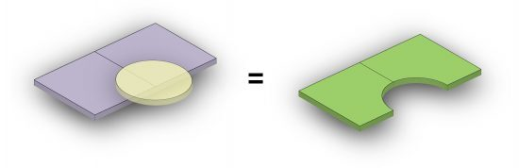
7. The Erase (Difference) Tool
I like the erase tool because it’s always helpful to erase things! The input layer is what will be erased. The erase feature determines what to erase. Simple as that.
The Erase Tool removes features that overlap the erase features. This geoprocessing tool maintains portions of input features falling outside the erase features extent. The result is a new feature with the erase feature extent removed.

Slide 9
You’re Ready to Take the Geoprocessing Training Wheels Off, We’ve sifted through the big 7 geoprocessing tools.

Slide 10
These are so common that ArcGIS and QGIS have added them to drop-down menus for easy access.
When you learn these 7 geoprocessing tools, you develop a good baseline of GIS skills. On top of that, you are one step closer to becoming a GIS guru.
But in reality, there are thousands of geoprocessing tools. Our GIS analysis section is a good place to start. Also, you check out Esri’s Spatial Analysis Map for more real-world examples of GIS Processing.

Slide 11
If you want a thorough outline of geospatial analysis, then make sure to check out our Periodic Table for Spatial Analysis.

Slide 12
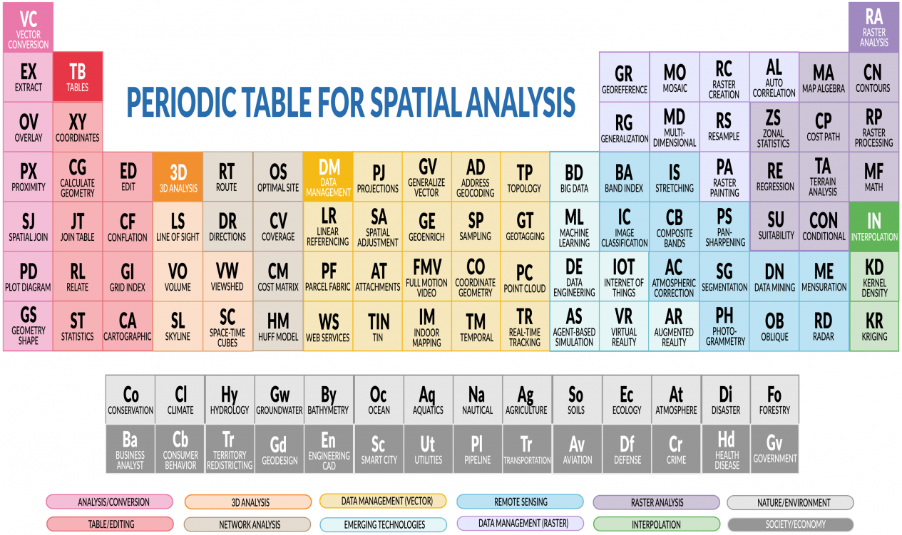

Slide 13
Introducing: The Periodic Table for Spatial Analysis
Spatial analysis may seem like alchemy to the inexperienced. But there is a science to it. By using spatial analysis, we can find patterns, quantify area, and predict outcomes with geography being the common link of it all.
Each element in the Periodic Table for Spatial Analysis contains a set of spatial analysis tools. We’ve grouped common tools by color with vector analysis tools on the left and raster analysis on the right.

Slide 14
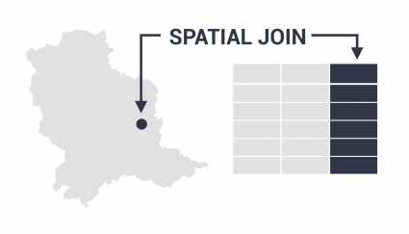
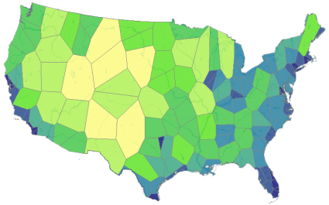
Vector Analysis/Conversion

Slide 15
Vector Analysis/Conversion
1. Vector Conversion [VC] – Converts file formats for points, lines, and polygons and alters data models from vector to raster or vice versa. (Feature to raster, rasterization vs vectorization) 2. Extract [EX] – Creates a subset of features by clipping, selecting, and splitting vector features. (Clip, select, and split) 3. Overlay [OV] – Overlays 2 or more vector layers and outputs layers based on overlapping features. (Intersect, union, erase tool) 4. Proximity [PX] – Generates output based on distances or proximity functions. (Buffer, Voronoi diagrams, and near functions) 5. Spatial Join [SJ] – Joins attributes from a separate layer based on distance or spatial relationship. (1-M Spatial join “Contains”, 1-1 Touches) 6. Plot Diagrams [PD] – Builds a graph or diagram based on a set of attributes and geographical locations. (Scatter plot, histograms, bar plots) 7. Geometry Shape [GS] – Computes the geometric shape of an object. (Compactness, perimeter/area ratio, rectangular fit).

Slide 16
Tables

Slide 17
8. Table Tools [TB] – Performs table functions for storing attribute data (Add field, create domains, reorder fields)
9. Add XY Coordinates [XY] – Converts a table of XY coordinates (latitude/longitude) into a layer with a defined coordinate system. (Add lat/long coordinates)
10. Calculate Geometry [CG] – Computes the length of the geometric measurements in the attribute table of vector features. (Calculate length/area)
11. Join Table [JT] – Appends the attribute columns from one table into another table based on matching record keys. (1:1, 1:M, M:N)
12. Relate [RL] – Generates a temporary table that displays matching records that associate with one or more matching records. (Relate vs Join)
13. Statistics [ST] – Calculates statistics based on a numerical field in a table. (RMSE, MAE, sum, mean, count, standard deviation).

Slide 18
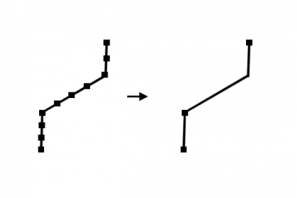
Editing/Cartography
14. Editing [ED] – Performs an editing function using the vertices and geometry in one or more layers. (Editing tools, densify, trim, snap, and extend) 15. Conflation [CF] – Resolves conflicts between two layers that display the same features with mismatching geometries. (Edge-matching, rubber sheeting, conflation) 16. Grid Index [GI] – Produces a set of consecutive rectangular map sheets that follow a linear feature for mapbook production. (Strip Map, fishnet, tessellation, QGIS Atlas, data driven pages) 17. Cartographic [CA] – Enhances or generalizes features in a dataset for cartographic display and aesthetic

